Slide 1


Slide 2

BLOCKCHAIN P3. ETHEREUM
Chainos Solution
2019/03/29

Slide 3
CHAINOS SOLUTION JSC
Blockchain technology
AGENDA
Ethereum history
Advantages and disadvantages
Greatest things
Discussion

Slide 4

CHAINOS SOLUTION JSC
Blockchain technology
Ethereum history
Vitalik Buterin, Gavin Wood, Joseph Lubin
30/7/2015
The DAO event (2016) – 50 millions $
1433$/ETH (14/01/2018)
140$/ETH (28/03/2019)
500$, 908$, 1200$, 1400$, 2500$ (end of 2019 - prediction)

Slide 5

CHAINOS SOLUTION JSC
Blockchain technology
Advantages and disadvantages
2.1. Advantages
Smart contract
Great roadmap
Short block-time
Smaller fee than bitcoin
GPU-friendly, ASIC-hard
Greatest community
Very friendly wallets
...

Slide 6

CHAINOS SOLUTION JSC
Blockchain technology
Advantages and disadvantages
2.2. Disadvantages
Waste of electricity
Slower than EOS, IOTA

Slide 7
CHAINOS SOLUTION JSC
Blockchain technology
Greatest things
3.1. Blocks connection
https://coincodex.com/article/2129/ethereum-token-standards-erc20-erc721-erc223-and-more/

Slide 8
CHAINOS SOLUTION JSC
Blockchain technology
Greatest things
3.2. Addresses
Normal address: controlled by private key
Contract address: controlled by code

Slide 9
CHAINOS SOLUTION JSC
Blockchain technology
Greatest things
3.3. Wallets
Metamask (browser extension)
MyEtherWallet (web application)
Atomic wallet (desktop application)

Slide 10
CHAINOS SOLUTION JSC
Blockchain technology
Greatest things
3.4. Gas limit, gas price

Slide 11
CHAINOS SOLUTION JSC
Blockchain technology
Greatest things
3.5. Transaction
Each transaction contain:
nonce
gasprice
gaslimit
to
value
data
v, r, s (signature)

Slide 12
CHAINOS SOLUTION JSC
Blockchain technology
Greatest things
3.6. Smart contract
Solidity
Smart contract code can:
Send ETH to other address
Read/Write data
Call other contracts
Deploy other contracts

Slide 13

CHAINOS SOLUTION JSC
Blockchain technology
Greatest things
3.6.1. Token
178 096 token contracts (01h00 – 29/03/2019)
3.98 millions $ (top 5 token contracts)
BNB (Binance): 2.38 millions $
Token standards: ERC20, ERC223, ERC-721, ERC-777
https://coincodex.com/article/2129/ethereum-token-standards-erc20-erc721-erc223-and-more/

Slide 14
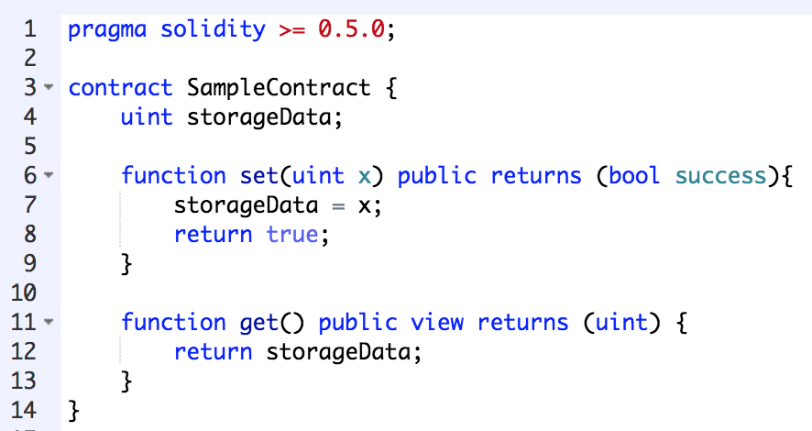
CHAINOS SOLUTION JSC
Blockchain technology
Greatest things
3.6.2. Sample smart contract code

Slide 15
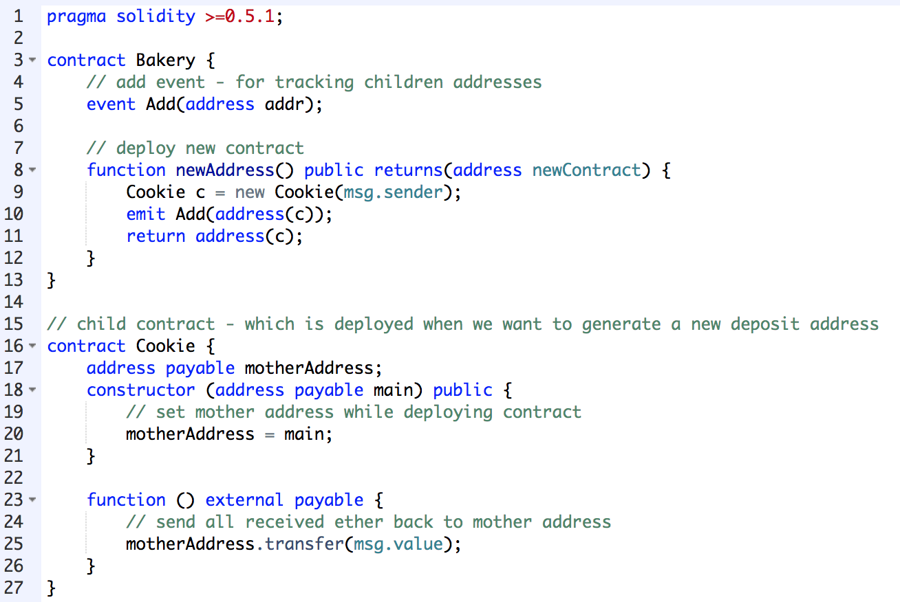
CHAINOS SOLUTION JSC
Blockchain technology
Greatest things
3.6.2. Sample smart contract code

Slide 16
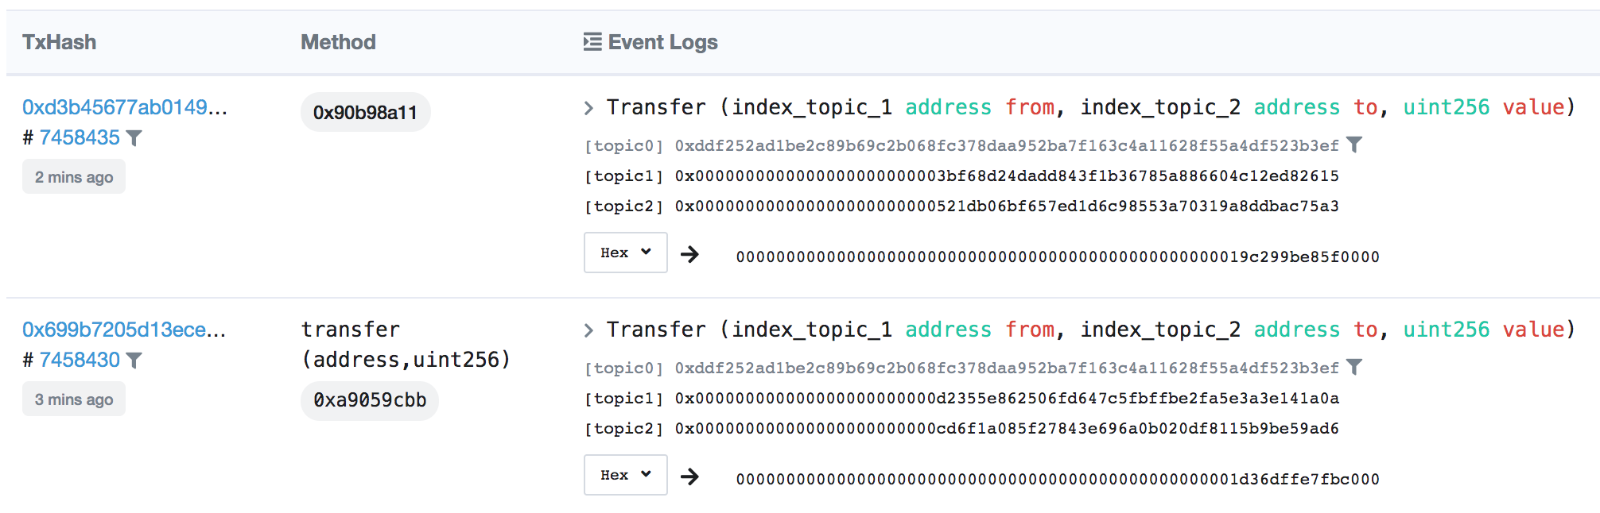
CHAINOS SOLUTION JSC
Blockchain technology
Greatest things
3.6.3. Smart contract events

Slide 17
CHAINOS SOLUTION JSC
Blockchain technology
Greatest things
3.6.4. Code and test, deploy smart contract
Remix IDE
Metamask
Truffle
Solidity compiler
GETH

Slide 18
CHAINOS SOLUTION JSC
Blockchain technology
Discussion

Slide 19

CHAINOS SOLUTION JSC

